Slide 1
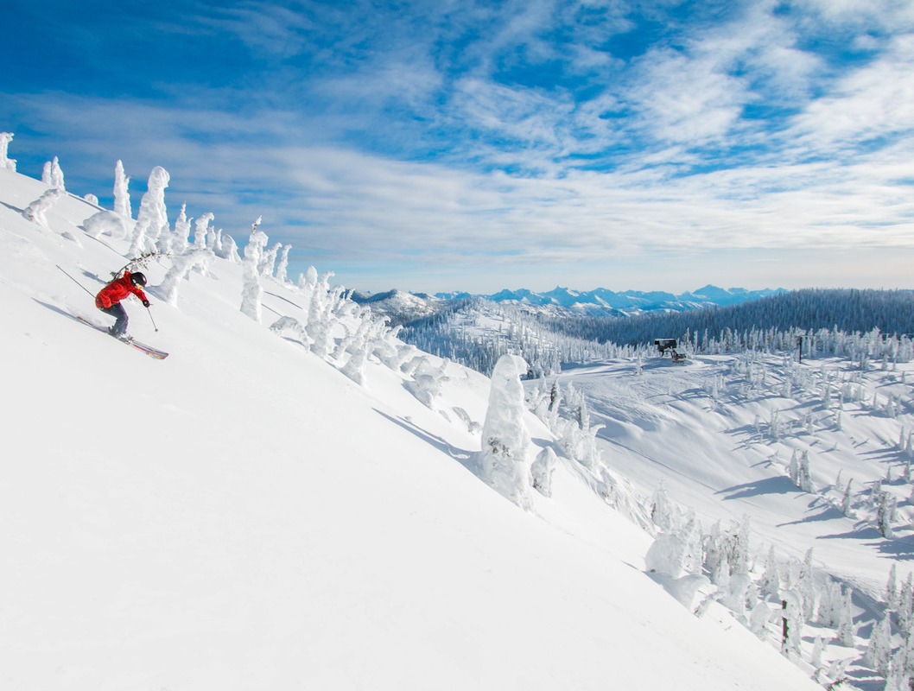
Business Analysis for Big Mountain Resorts
Soyoung An

Slide 2
Overview
Big Mountain Resort is a ski resort located in Montana, has recently installed additional chair lift to help increase the distribution of visitors across the mountain. This additional chair increases the operating costs by $1.54 M this season. Therefore, the resorts plan to charge a premium above the average price of resorts. However, they are not sure the optimal ticket price that can generate an additional $1.7 M revenue in next year.
Goal: To identify competitive ticket prices, and opportunity to improve the profit.
Data: Recent ski slope terrain & pricing data from other ski resorts in the U.S. market share.
330 rows 27 features
Notes:
The ski resort project is for Big Mountain Ski resort located in Montana. Big Mountain has installed an additional chair lifts to help increase the distribution of visitors across the mountain. which has increased its operation cost by $1.54 M this season. The resort wants to charge a premium above the average price of resorts in the market segment. So, they wanted to investigate to see if this will be beneficial for the business. Also, they want to find business strategies capitalizing on its facilities as much as possible and improve their profit margin.

Slide 3
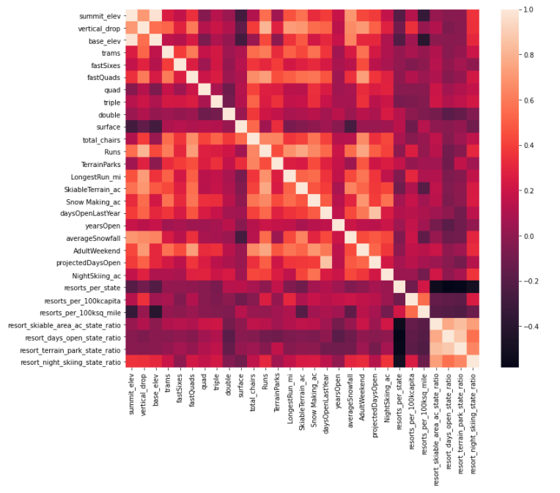
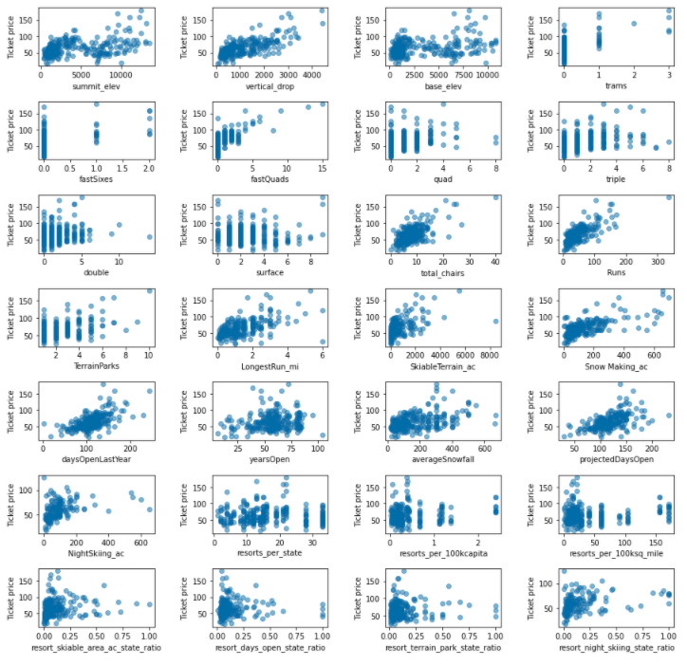
Important factors affecting the price
Top 4 features
vertical_drop
fastQuads
total_chairs
Runs
Heatmap
Scatter plots
The relationship between Ticket price vs. other features
Notes:
Exploring the data with pca which is a machine learning technique to reduce the dimensionality for better visualization and analysis and we have plot the correlation between tick price and other features using scatter and heatmap. Adult ticket price have high positive correlation with vertical drops, fast quads, total chair numbers, and number of runs.

Slide 4
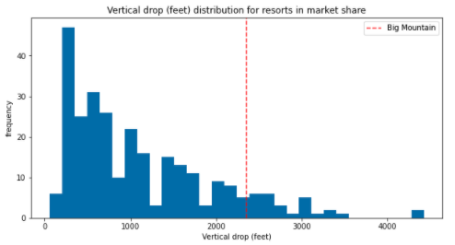
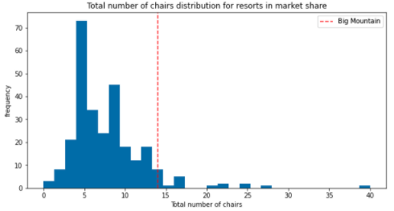
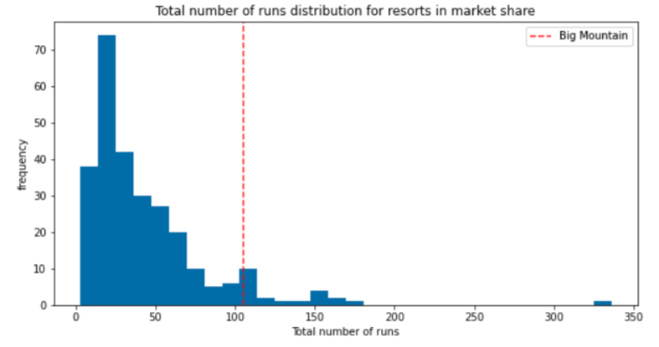
Top 4 features distributions comparing to the market
Vertical Drop (ft)
Fast quads
Total number of chair
Total number of runs
Notes:
Big Mountain is doing well for vertical drop, but there are still quite a few resorts with a greater drop. Most resorts have no fast quads. Big Mountain has 3, which puts it high up that league table. There are some values much higher, but they are rare. Big Mountain has amongst the highest number of total chairs, resorts with more appear to be outliers. Big Mountain compares well for the number of runs. There are some resorts with more, but not many.

Slide 5
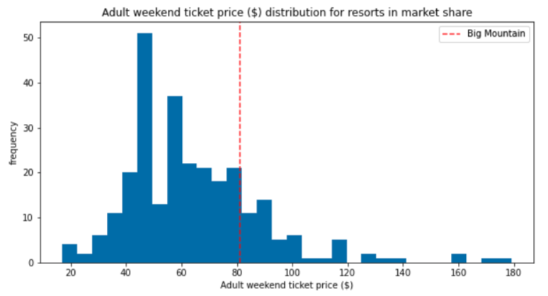
Model Results & Analysis
Big Mountain Current Ticket Price: $81.00
Modelled Ticket Price: $95.87
Mean absolute error: $10.39
85.97
Ticket Price distribution of Big Mountain comparing to market
Room for an Increase!!!
Big Mountain Current Ticket Price is already fairly high compare to the market.
WHY IS ITS MODELED PRICE SO MUCH HIGHER???
Notes:
Big Mountain currently charge 81 dollars for an adult in the Weekend. The best model was RandomForest Model and Big Mountain Resort modelled price is 95.87 dollars. Even with the expected mean absolute error of 10.39 dollars, this suggests there is room for an increase.
The Big Mountain Ski Resorts have fairly higher ticket price compare to other ski resorts in US. However, they have several sectors where they belong in top league. Big Mountain has the amongst the highest number of total chair, resorts with more appear to be outliers. Most resorts have no fast quads. Big Mountain has 3 fast quads, which put Big Mountain resorts high up in the league. There are some values much higher, but they are rare. Big Mountain compares well for the number of runs. There are some resorts with more, but not many. Big Mountain has one of the longest runs. Although it is just over half the length of the longest, the longer ones are rare. Big Mountain is amongst the resorts with the largest amount of skiable terrain. Also, looking at the ticket price graph above, Big Mountain Ski Resorts ticke price tends to be located in a little higher than mean but not towards the highest. Comparing with other ski resorts features, the price is pretty reasonable.

Slide 6
Recommendations
Two Model Scenarios can increase the ticket price to $2 more which increase the revenue to $3,464,638:
Adding a run, increase the vertical drop by 150 feets, and installing an additional chair lift (as planned)
OR/AND
Adding 2 acres of snow making area
Notes:
And I have discovered a business strategy that which can increase the revenue to $3.5 Million in the revenue by adding a run and increasing the vertical drop by 150 feets and installing additional chair lift as planned and optionally by adding 2 acres of snow making area would help to increase the revenue.

Slide 7
Conclusions
Big Mountain resort can improve in the coming year, particularly with an extra lift chair. The business can raise the ticket price to a competitive value compared to the market rate and still generate large increase in revenue.

